Slide 1
UNH FEST
BY
SAHITHI POLADI
UNDER
TAMARA LUARASI

Slide 2
INTRODUCTION
Designed a website where UNH students can check the events which are being held in the university.
Students can view the events after they are registered.
(Registration and login)
Existing member can directly login and then register for an event which they want to attend.

Slide 3
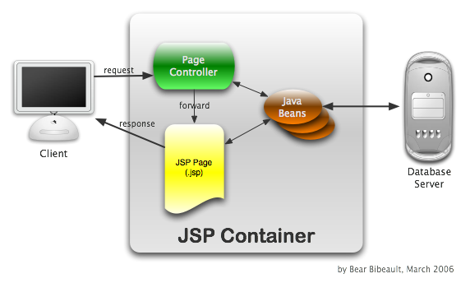
ARCHITECTURE
The architecture used to design the website is MVC Model-2 First Case Architecture.

Slide 4
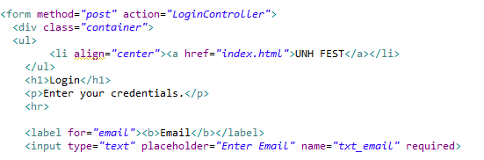
LOGIN PAGE
login.jsp

Slide 5
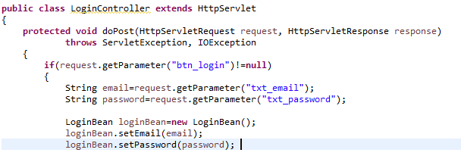
LoginController.java

Slide 6
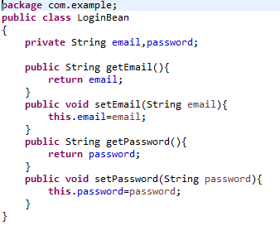
LoginBean.java

Slide 7
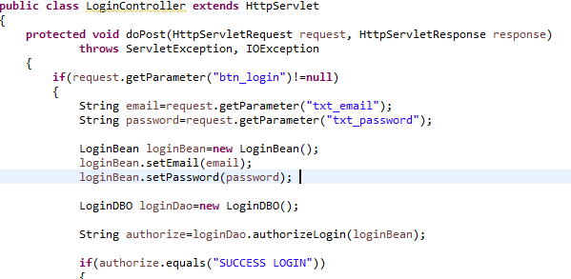
LoginController.java

Slide 8
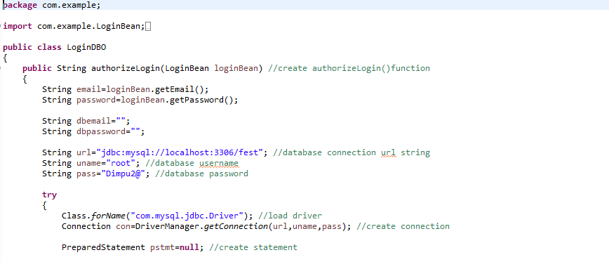
LoginDBO.java

Slide 9
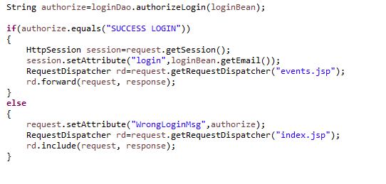
LoginController.java

Slide 10
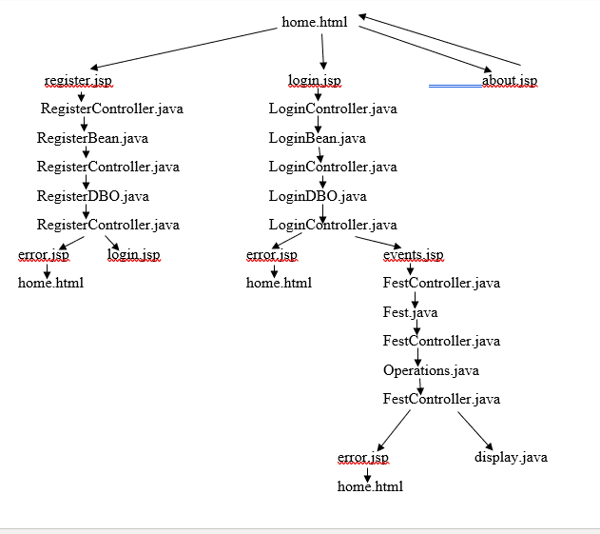
Flow Diagram of Project

Slide 11
DEMO

Slide 12
QUESTIONS??

